Slide 1
Finite Automata
Anab Batool Kazmi

Slide 2
Finite Automata
Finite State Automata (FSA) or Finite State Machine (FSM)
In finite Automata we represent language diagrammatically.

Slide 3
Finite Automata
FA is a model of a system with discrete inputs and outputs
The system can be in any ONE of a finite number of the internal configurations or States.
The states of the system summarizes the information concerning the past inputs that is needed to determine the behavior of the system on subsequent inputs.
The system is changing the state as a result of new inputs.

Slide 4
Finite Automata
Consists of finite set of states having exactly one start state and one or more end states
.
An alphabet Σ of possible input letters.
Finite set of transitions which tells which state to move.
-
+

Slide 5
Finite Automata
Finite Automata
Automata without output
Automata with output
Non deterministic Finite Automata
Deterministic Finite Automata
Mealy Machine
Moore Machine

Slide 6
Categories of Finite Automata
Two Categories
Deterministic Finite Automata (DFA)
The machine can exist in only one state at any given time.
Non Deterministic Finite Automata (NFA)
The machine can exist in multiple states at the same time.

Slide 7
Non Deterministic Finite Automata

Slide 8
Non Deterministic Finite Automata
Nondeterminism gives a machine multiple options for its moves.
In NFA given the current state there could be multiple next states.
The next state may be chosen at random.
All the next states may be chosen at parallel.

Slide 9
NFA
In a nondeterministic finite automaton (NFA), for each state there can be zero, one, two, or more transitions corresponding to a particular symbol.
If NFA gets to start with more than one possible transition corresponding to the input symbol, we say it branches.

Slide 10
Non Deterministic Finite Automaton
A nondeterministic finite automaton (NFA) is a 5-tuple (Q,∑, q₀,A, δ),
where
Q is a finite set of states;
∑ is a finite input alphabet;
q₀ ∈ Q is the initial state;
A ⊆ Q is the set of accepting final states;
δ : Q x (∑ ∪ {^}) →2^{Q} is the transition function.

Slide 11
Examples NFA
Single Letter R.E
R.E | NFA
R.E=a
R.E=b
R.E= ^
-
a
+
-
b
+
-
^
+

Slide 12
Examples NFA
R.E | NFA
R.E = a+b
R.E=ab
a
-
+
b
-
a,b
+
-
a
b
+

Slide 13
Examples NFA
All strings that ends with a. if Σ={a,b}
R.E=(a+b)* a
NFA:
Q={-,+} , q0= -, A= {+}
a
a,b
-
+

Slide 14
δ =
- × a → + ;
× a → - ;
- × b → - ;

Slide 15

Example – Null String as an Input
By convention, we say that the null string starts in the start state and ends also in the start state for all FAs.
Consider this FA:
The language accepted by this FA is the set of all strings except Λ.
The regular expression of this language is
(a + b)(a + b)* = (a + b)⁺
Notes:
15

Slide 16
Example
One of many FAs that accept all words is
Here, the ± means that the same state is both a start and a final state.
The language for this machine is
(a + b)*
Notes:
16

Slide 17
Examples NFA
All strings that starts with a and ends with bb . . when Σ={a,b}
R.E=a(a+b)*bb + ^
NFA:
a
b
b
-
+
2
3
+
4
a,b

Slide 18
Examples NFA
All strings that starts and ends with same letter. when Σ={a,b}
R.E= a(a+b)*a + b(a+b)*b
NFA:
a,b
-
a
a
+
b
b
a,b

Slide 19
Examples NFA
All strings that starts and ends with different letter. when Σ={a,b}
R.E= a(a+b)*b + b(a+b)*a
NFA:
a,b
-
a
1
b
+
b
a
2
a,b

Slide 20
Examples NFA
All strings that contain aa. when Σ={a,b}
R.E= (a+b)*aa (a+b)*
NFA:
a,b
a,b
-
a
a
+

Slide 21
Examples NFA
All strings of even length when Σ={a}
R.E= (aa)*
a
-
+
a

Slide 22
All strings of even length when null is not included Σ={a}
R.E =(aa).(aa)*
a
a
a
-
+
a

Slide 23
Examples NFA
All strings having even no. of b’s and any no of a . And null is included. when Σ={a,b}
R.E= a* (b a* b)* a*
b
a
-
+
a
b

Slide 24
Examples NFA
All strings of length 2 when Σ={0,1}
R.E= (0+1)(0+1)
0
0
-
+
1
1
-
0,1
0,1
+

Slide 25
Examples NFA
All strings multiple of 3.
R.E= ((a+b)(a+b)(a+b))*
-
+
a,b
a,b
a,b

Slide 26
Examples NFA
All strings that contain atleast one a and end with b.
R.E= (a+b)*a(a+b)*b
All strings
a,b
a,b
-
a
b
+

Slide 27
Example NFA of Numeric Literals
describe the language of numeric “literals,” which typically includes strings such as 14, +1, −12, 14.3, −0.99, 16.0, 3E14, −1.00E2, 4.1E−1, and 0.3E+2.
d=0 + 1 + 2 + ·· ·+9
s=( ^ ) + (+) + ( - )
p= .
R.E=sdd∗( ^+ pd∗d)(^ + Esd∗d)

Slide 28
14E8, +16E-9, 16.23E-21
d=0 + 1 + 2 + ·· ·+9
s=( ^ ) + (+) + ( - )
p= .
R.E = sdd*(pdd*+^) ( Esdd* + ^)

Slide 29
QUIZ
Write R.E That describe the language of numeric “literals,” which typically includes strings such as 14, +1, −12, 14.3, −.99, 16., 3E14, −1.00E2, 4.1E−1, and 0.3E+2.

Slide 30
NFA of Numeric Literals sd∗d( ^+ pd∗d)(^ + Esd∗d)
d
d
-
1
s
2
d
3
+
p
4
d
+
5
^
E
6
^
S
d
d
7
+
8

Slide 31
-
1
a
2
b
3
b
4
a,b
+
5
b
a
a
a,b
6
b
a
L={abbb,abba,baab,babb}
D
7
a,b
a
a,b
a,b
8
b
+
9

Slide 32
When the string is acceptable by NFA?
If there is any way to run the machine that ends in any set of states out of which one state is the final state, then the NFA accepts.
An NFA accepts a string x if it can get to an accepting state on input x.
Think of it as trying many options in parallel, and hoping one path gets lucky
Transition Q × ∑ → ϕ is possible
the NFA treats this as a rejecting path (the string may still reach an accepting state by another path)
A convenient shortcut for our “hell/rejection/black-hole” state

Slide 33
NFA accepting a string
Set of all strings that ends with 0. ∑={0,1}
R.E=(0+1)*0
Q={A,B}
q_{o}= A
δ=
A x 0 → A
A x 0 → B
A x 1 → A
B x 0 → ϕ
B x 1 → ϕ
-
A
E.G) 100
1
0,1
0
-
A
+
B
A
0
0
In the end we are in state A or B and B is accepting state. So 100 is accepted.
A
B
A
ϕ
B

Slide 34
NFA not accepting a string
Set of all strings that ends with 0. ∑={0,1}
R.E=(0+1)*0
Q={A,B}
q_{o}= A
δ=
A x 0 → A
A x 0 → B
A x 1 → A
B x 0 → ϕ
B x 1 → ϕ
E.G) 01
0,1
0
-
A
+
B
-
A
0
In the end we are in state A or ϕ and both are not at all accepting states. So 01 is not accepted.
A
B
1
A
ϕ

Slide 35
Deterministic Finite Automata

Slide 36
Deterministic Finite Automata
“DFA which is also known as a deterministic finite acceptor (DFA) and a deterministic finite state machine (DFSM)—is a finite-state machine that accepts and rejects strings of symbols and only produces a unique computation (or run) of the automaton for each input string.”

Slide 37
Deterministic Finite Automata
In DFA given the current state we know what the next state will be.
For every state, for every symbol is in ∑, there is exactly one arrow labeled with that symbol going to another state.
It has no choices or randomness
It is simple and easy to design

Slide 38
Dead End State
Also known as Dead State, Waste Basket or Davey John Locker, as the moment one enters these states there is no way to leave it.
A rejecting state that is essentially a dead end. Once the machine enters a dead state, there is no way for it to reach an accepting state, so we already know that the string is going to be rejected.
A machine may have multiple dead states, but at most only one dead state is needed per machine.

Slide 39
Formal Definition of DFA
A DFA can be represented by a 5-tuple (Q, ∑, δ, q₀, F) where −
Q is a finite set of states.
∑ is a finite set of symbols called the alphabet.
δ is the transition function where δ: Q × ∑ → Q
q₀ is the initial state from where any input is processed (q₀ ∈ Q).
F is a set of final state/states of Q (F ⊆ Q).

Slide 40

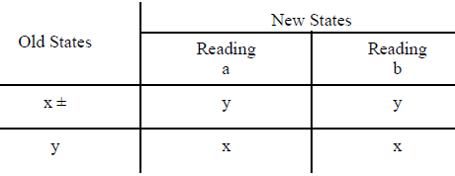
Strings of even length
The language of strings defined over ∑={a,b} of even length.
R.E=((a+b)(a+b))*
Q={x,y}
q_{o}=x
A=x

Slide 41
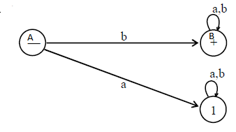
Strings starting with b
The language L of strings, defined over Σ={a, b}, starting with b.
R.E: b (a+b)*
Q={A,B,1}
q_{o}=A
A={B}
Dead End State = 1
Old States | New States
 | Reading a | Reading b
A - | 1 | B
B + | B | B
1 | 1 | 1

Slide 42
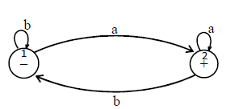
Ending in ‘a’ or not ending in ‘b’.
The language L of strings, defined over Σ={a, b}, ending in a or not ending in b.
R.E=(a+b)* a
Q={1,2}
q_{o}=1
A=2
Old States | New States
 | Input a | Input b
1 - | 2 | 1
2 + | 2 | 1

Slide 43
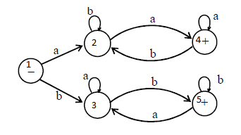
Beginning with and ending in same letters.
the Language L of Strings of length two or more, defined over Σ = {a, b}, beginning with and ending in same letters.
R.E=
a (a+b)* a + b (a+b)* b
Q={1,2,3,4,5}
q_{o}=1
A={4,5}
Old States | New States
 | Input a | Input b
1 - | 2 | 3
2 | 4 | 2
3 | 3 | 5
4 + | 4 | 2
5 + | 3 | 5

Slide 44
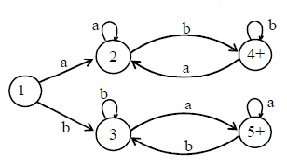
beginning with and ending in different letters
the Language L of Strings, defined over Σ = {a, b}, beginning with and ending in different letters.
R.E=a (a+b)* b + b (a+b)* a
Q={1,2,3,4,5}
q_{o}=1
A={4,5}
Old States | New States
 | Input a | Input b
1 - | 2 | 3
2 | 2 | 4
3 | 5 | 3
4 + | 2 | 4
5 + | 5 | 3

Slide 45
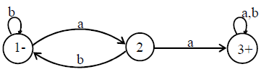
String containing double a
The Language L of strings , defined over Σ = {a, b}, containing double a.
R.E=(a+b)* aa (a+b)*
Q={1,2,3}
q_{o}=1
A=3
Old States | New States
 | Input a | Input b
1 - | 2 | 1
2 | 3 | 1
3 + | 3 | 3

Slide 46
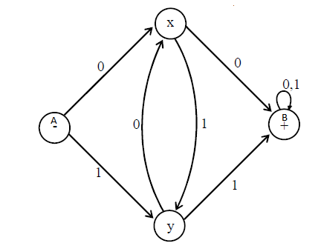
having double 0’s or double 1’s,
The language L of strings, defined over Σ={0, 1}, having double 0’s or double 1’s,
R.E=(0+1)* (00+11) (0+1)*
Q={A,B,x,y}
q_{o}=A
A=B
Old States | New States
 | Input 0 | Input 1
A- | x | y
x | B | y
y | x | B
B+ | B | B

Slide 47
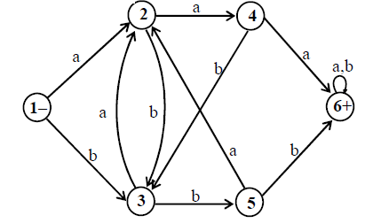
Having triple a’s or triple b’s.
The language L of strings, defined over Σ={a, b}, having triple a’s or triple b’s.
R.E=(a+b)* (aaa+bbb) (a+b)*
Q={1,2,3,4,5,6}
q_{o}=1
A=6
Old States | New States
 | Input a | Input b
1 - | 2 | 3
2 | 4 | 3
3 | 2 | 5
4 | 6 | 3
5 | 2 | 6
6+ | 6 | 6

Slide 48
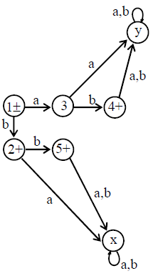
L = {Λ, b, ab, bb}
L = {Λ, b, ab, bb}, defined over Σ ={a, b},
R.E=Λ + b + ab + bb OR
R.E= Λ + b (Λ + a + b)
Q={1,2,3,4,5}
q_{o}=1
A={1,2,4,5}
Dead State: {x,y}
Old States | New States
 | Input a | Input b
1 ± | 3 | 2
2+ | x | 5
3 | y | 4
4 + | y | y
5+ | x | x
x | x | x
y | y | y

Slide 49
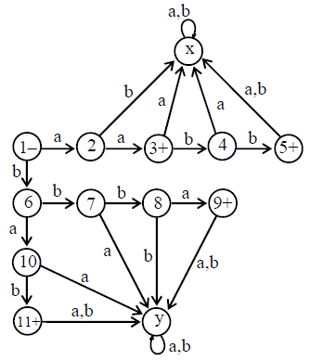
L = {aa, bab, aabb, bbba}
L = {aa, bab, aabb, bbba}, defined over Σ ={a, b}
R.E=aa + bab + aabb + bbba OR
R.E= aa (Λ + bb) + b (ab + bba)
Q={1,2,3,4,5,6,7,8,9,10,11,x,y}
q_{o}=1
A={3,5,9,11}
Dead State: {x,y}

Slide 50
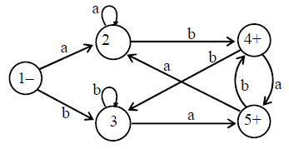
neither ends in aa nor bb
neither ends in aa nor bb. (means ends in ab or ba)
R.E=(a+b)* (ab + ba)
Σ ={a, b}
Q={1,2,3,4,5}
q_{o}=1
A={4,5}

Slide 51
R.E=(ab+ba)(ab+ba)*
R.E=(ab+ba)(ab+ba)*
a
a
a
b
a
-
+
b
D
b
a
b
b
a
b

Slide 52
Don’t Ends at Example
For such conditions some times it is difficult to make direct DFA, So we have an alternative
First make DFA for “ends at”
Then Convert all non accepting states to accepting states and vice versa

Slide 53
Don’t End at ab
Don’t Ends at ab
R.E=(a+b)*(aa+ba+bb)
Ends at ab
R.E=(a+b)*ab
a
a
a
a
a
a
b
-
+
+
-
+
b
b
b
b

Slide 54
Don’t Ends at bba
Ends at bba
R.E=(a+b)*bba
Don’t ends at bba
b
b
a
-
b
b
a
+
-
+
b
+
b
+
a
a
a
a
a

